Slide 1
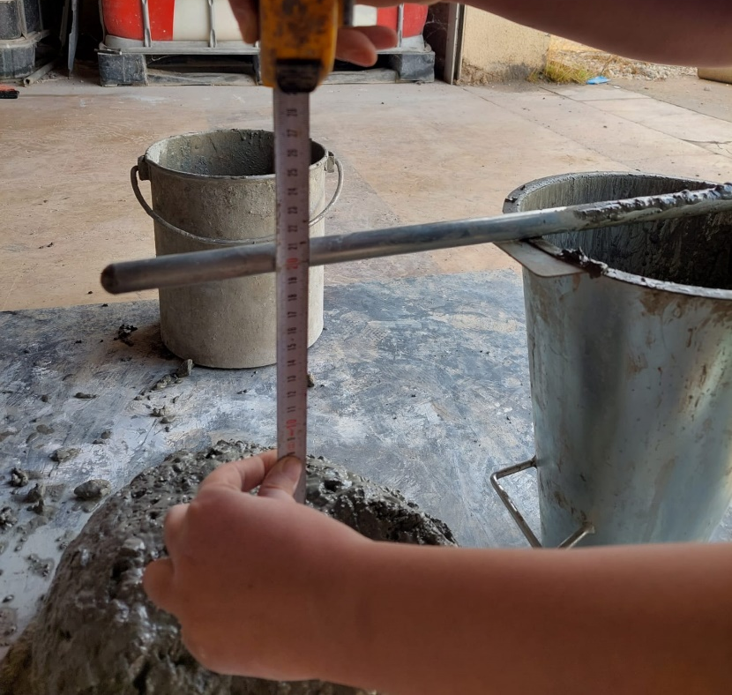
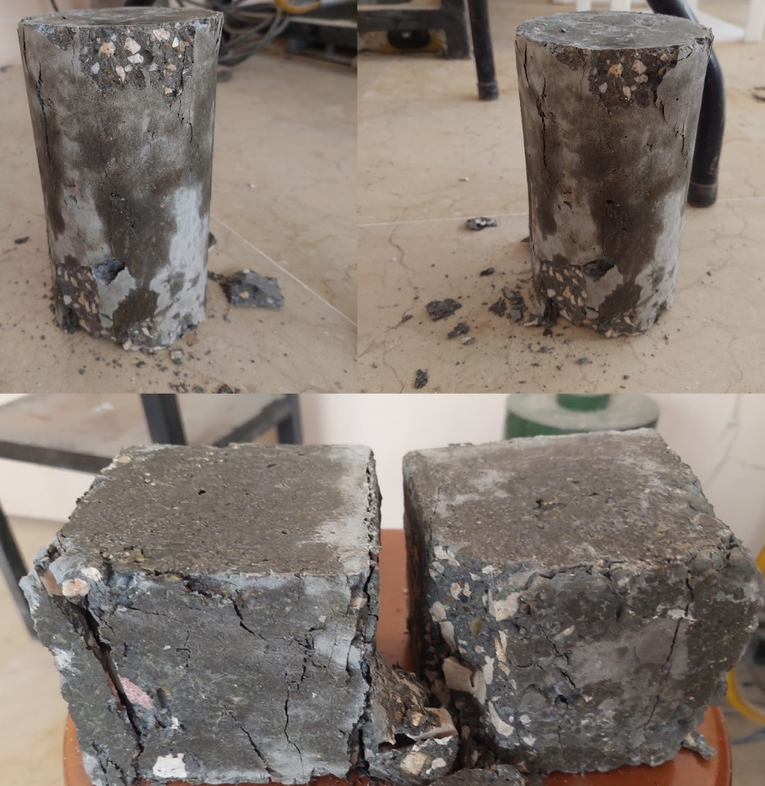
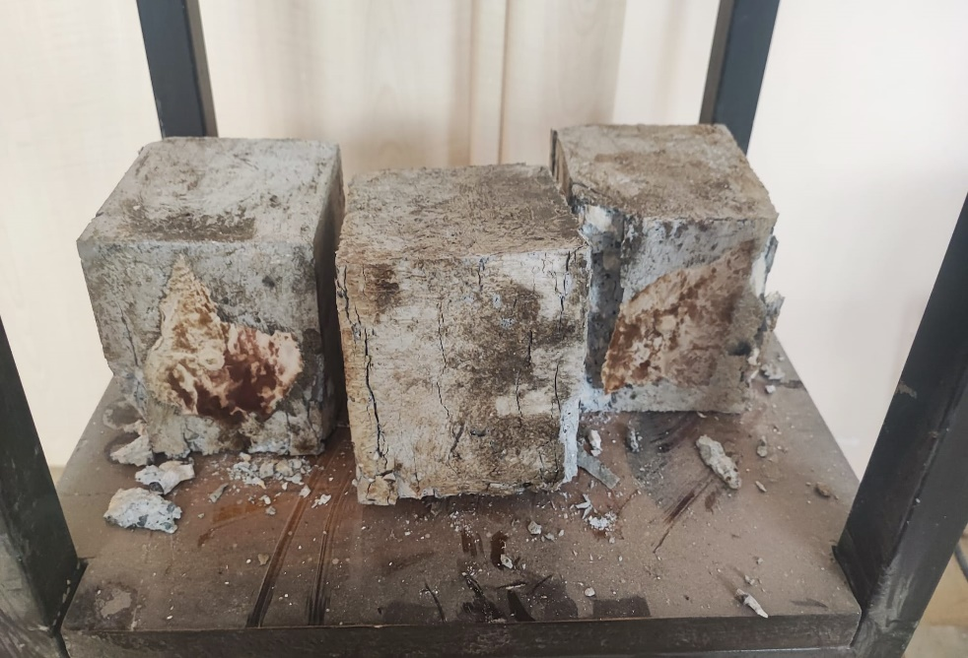
DESIGN OF HIGH STRENGTH CONCRETE Rojda KAYACAN Supervisor: Assoc. Prof. Dr. Nihat ATMACA
CE 499 Civil Engineering Design
2022-2023 Fall
ABSTRACT
INTRODUCTION
MATERIALS & METHODS
RESULTS & DISCUSSIONS
The engineering characteristics and economic advantages of high-strength concrete (HSC) are distinct from conventional concrete, thereby popularizing the HSC concrete in a large variety of applications in the construction industry. In this graduation thesis study, HSC was designed according to TS EN 206+A2. Concrete samples prepared in the laboratory were subjected to workability, standard compression and non-destructive tests which are rebound hammer and ultrasonic pulse velocity. Some of the samples were exposed to the effect of high temperature and the durability properties of the concrete were also examined. As a result, it was concluded that non-destructive methods alone are not sufficient to determine the strength of concrete and that the effect of high temperature reduces the strength of concrete.
Having the word “strength” in its name undeniably suggests a bias towards one property only; however, high-strength concrete can be an advantageous material with respect to other properties, both mechanical and durability related. Nevertheless, it is crucially important to recognize that the achievement of high strength alone should never summarily serve as a surrogate to satisfying other important concrete properties. It would seem logical that strong concrete would be more durable, and in many respects, the lower permeability that comes along with higher strength often does improve concrete’s resistance to certain durability related distress, but unlike strength, the prerequisites for durability are not easily defined. In fact, depending on the manner in which higher-strength is achieved, the durability of high-strength concrete could actually diminish. Rather, the changes that occur when progressing up the strength ladder are quite subtle with each advancing step. As the water/binder ratio changes, so do the principles governing mix proportioning, which in turn establishes strength and other mechanical properties. In order to develop an intuitive understanding of how it is possible to produce concretes four to five times stronger than conventional concrete, any beliefs that the principles governing concrete proportioning change little should be abandoned from this point on.
Raw Materials:
Slump Test: To measure the workability slump test was used.
Ultrasonic Pulse Velocity Test: Ultrasonic pulse velocity methods involve propagating ultrasonic waves in solids while measuring the time taken for the waves to propagate between a sending and receiving point. The features of ultrasonic wave propagation can be used to characterize a material's composition, structure, elastic properties, density and geometry using previously established correlations, known patterns and mathematical relationships.
Rebound Hammer Test: Upon impact with the concrete surface, the rebounded hammer records a rebound number which presents an indication of strength properties by referencing established empirical correlations between strength properties of concrete (compressive and flexural) and the rebound number.
Compression Test: Concrete samples were subjected to compression tests to ascertain their compressive strength.
Slump Test Result
7-day Test Results
28-day Test Results
Deformed shape of 7-day specimens after compression test
Deformed shape of 28-day cube samples after compression test which were exposed to high temperature.
Material | ρ (kg/dm³) | Water Absorption (%) | Humidity (%)
Natural Sand | 2.62 | 1.8 | 1.8
Naturally shaped coarse aggregate | 2.73 | 0.8 | 0
Crushed stone | 2.80 | 0.5 | 0
CEM I 42.5 N | 3.15
Glenium C303 Superplasticizer | 1.05
Results Under Normal Temperature | Cylinder 1 | Cylinder 2 | Cube 1 | Cube 2
UPV (m/s) | 4577 | 4505 | 5025 | 4902
Rebound Number | 26.73 | 28.20 | 17.60 | 25.60
Compressive Strength (MPa) | 40.77 | 39.53 | 54.47 | 61.17
Results Under Normal Temperature | Cylinder 1 | Cylinder 2 | Cube 1 | Cube 2
UPV (m/s) | 4405 | 4525 | 4785 | 4566
Rebound Number | 29.83 | 36.13 | 24.00 | 30.40
Compressive Strength (MPa) | 34.94 | 40.43 | 77.94 | 76.53
Results Under High Temperature | Cylinder 1 | Cylinder 2 | Cube 1 | Cube 2 | Cube 3
UPV (m/s) | 3697 | exploded | 4184 | 4274 | 4219
Compressive Strength (MPa) | 36.36 |  | 58.81 | 52.38 | 59.51
Rebound Number | 31.13 |  | 27.67 | 27.60 | 23.27
CONCLUSION
7-day and 28-day specimens exhibited similar performance in terms of ultrasonic pulse velocity. However, it is clear to see that specimens which were exposed to high temperature had substantially lower ultrasonic pulse velocities. This is another indication that the effect of high temperature causes deterioration in the internal structure of the concrete. It is observed that the 7-day UPV results are higher than the 28-day UPV results. However, the 28-day compressive strength of the concrete was significantly higher for the cube samples. This shows that the obtained UPV value is not always correlated with the compressive strength.
The effect of high temperature or normal temperature for 7 days or 28 days does not proportionally affect the rebound number. This indicates that the rebound hammer test alone is not sufficient to evaluate the strength or durability properties of concrete, except for surface hardness.
Interestingly, the 7-day cylinder samples achieved higher compressive strength than the 28-day cylinder samples under normal temperature. It is thought that this is due to the concrete not being well placed in these molds. Apart from that, the cylinder sample under the influence of high temperature showed lower performance than both normal 7-day and 28-day samples, as expected.
28-day concrete samples under normal temperature reached higher compressive strength than both normal 7-day specimens and 28-day specimens under the influence of high temperatures. In addition, 28-day concrete samples which were exposed to high temperature has 26% lower compressive strength than normal 28-day concrete and 2% lower than 7-day normal concrete
REFERENCES
Figure 1 Comparison of UPV test results
Figure 2 Comparison of rebound hammer test results
Caldarone, concrete: a practical guide. CRC press, 2014.
Dwivedi, Sandeep Kumar, Manish Vishwakarma, and Akhilesh Soni. "Advances and researches on non-destructive testing: A review." Materials Today: Proceedings 5.2 (2018): 3690-3698.
Helal, James, Massoud Sofi, and Priyan Mendis. "Non-destructive testing of concrete: A review of methods." Electronic Journal of Structural Engineering 14.1 (2015): 97-105.
BSI. "BS 8500-1: 2015+ A2: 2019. Concrete. Complementary British Standard to BS EN 206. Method of specifying and guidance for the specifier." (2019).
Standard, Türk. "Design of concrete mix." Turkish. TS802, Türk Standartları Enstitüsü , Ankara (2016).
Michael A. High-strength
Figure 3 Comparison of average compressive strength of cylinder specimens.
Figure 4 Comparison of average compressive strength of cube specimens.
Figure 5 Granulometry curve of aggregate mixture
Figure 6 Exploded cylinder sample in the laboratory oven.

