Slide 1

DESIGN OF A RESIDENTIAL BUILDING
IN GAZIANTEP
CE 499
CIVIL ENGINEERING DESIGN
BY
Huseyin Emre OZKALELI
201731960
SUPERVISOR
Prof.Dr. Abdulkadir CEVIK

Slide 2
TABLE OF CONTENTS
1. ABSTRACT
2. THE RESIDENTIAL BUILDING PROJECT
3. ARCHITECTURAL DRAWINGS OF THE PROJECT
4. BUILDING PARAMETERS RELATED WITH TBDY 2018
5. STRUCTURE GENERAL INFORMATIONS
6. MATERIAL INFORMATIONS
7. BUILDING SUMMARY REPORT
8. FIGURES AFTER ANALYSIS
9. CONCLUSION
10. REFERENCES

Slide 3
1. ABSTRACT
In this project, a residential building with 5 floors was modeled bearing systems such as column, beam, slab, shear wall and foundation according to the Turkish Building Earthquake Code and TS500 over IDECAD, and then static analysis was performed on the same program. While analyzing, the project was modeled for a residential building to be built in Gaziantep, taking into account the coordinates and earthquake spectra of the province of Gaziantep. As a result of the analysis, it was not seen with any project errors. The reports and results obtained as a result of the structure analysis are shown in detail in this project.

Slide 4
2. THE RESIDENTIAL BUILDING PROJECT
The need for housing and the concept of space formed in accordance with this need arose as a result of the effort to live in nature. Housing and residential design, which meets the concept of housing, coincides with the historical development of man and has survived to the present day, taking into account the concept of architecture. The spatial formation of these concepts arises as a result of all the qualities of man, physical, social and economic. These qualities are also the main determinants of the concept of culture, which is a human trait. Wherever a person is mentioned, there is a culture. Culture can be explained by some biological, some social, completely human sub-concepts such as knowledge, accumulation, experience, education. The need for housing is also shaped by the influence of culture, and housing and housing design are differentiated as a result of all these contexts.

Slide 5
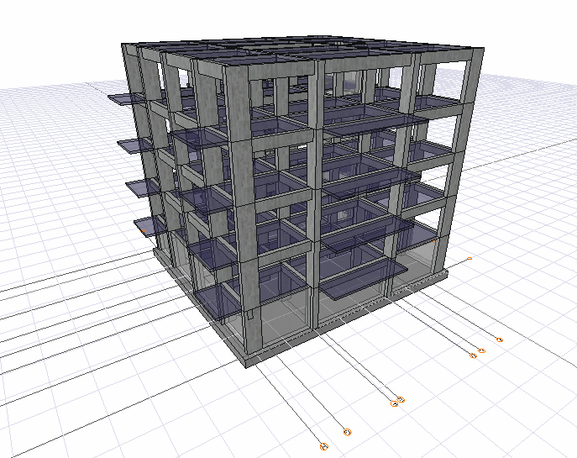

Slide 6
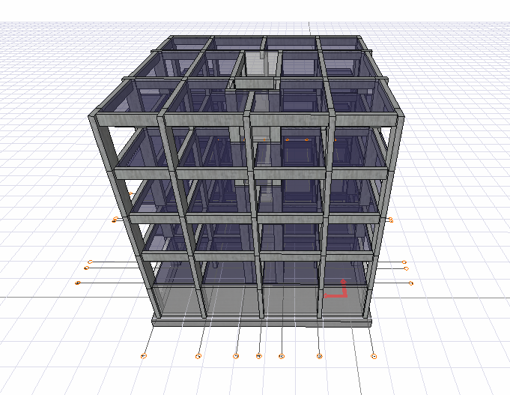

Slide 7
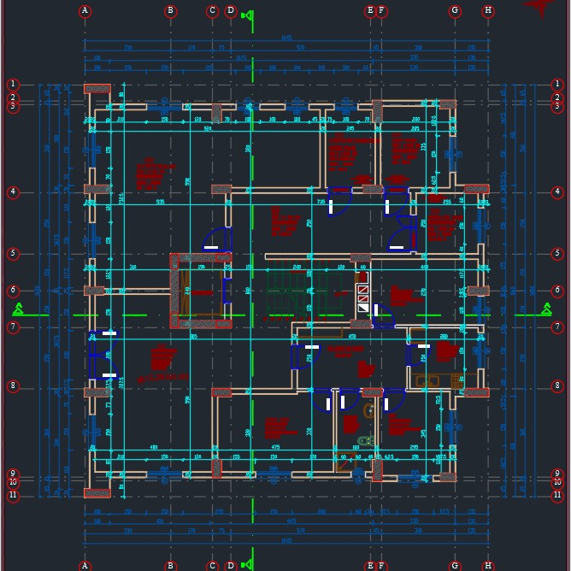
3. ARCHITECTURAL DRAWINGS OF THE PROJECT

Slide 8
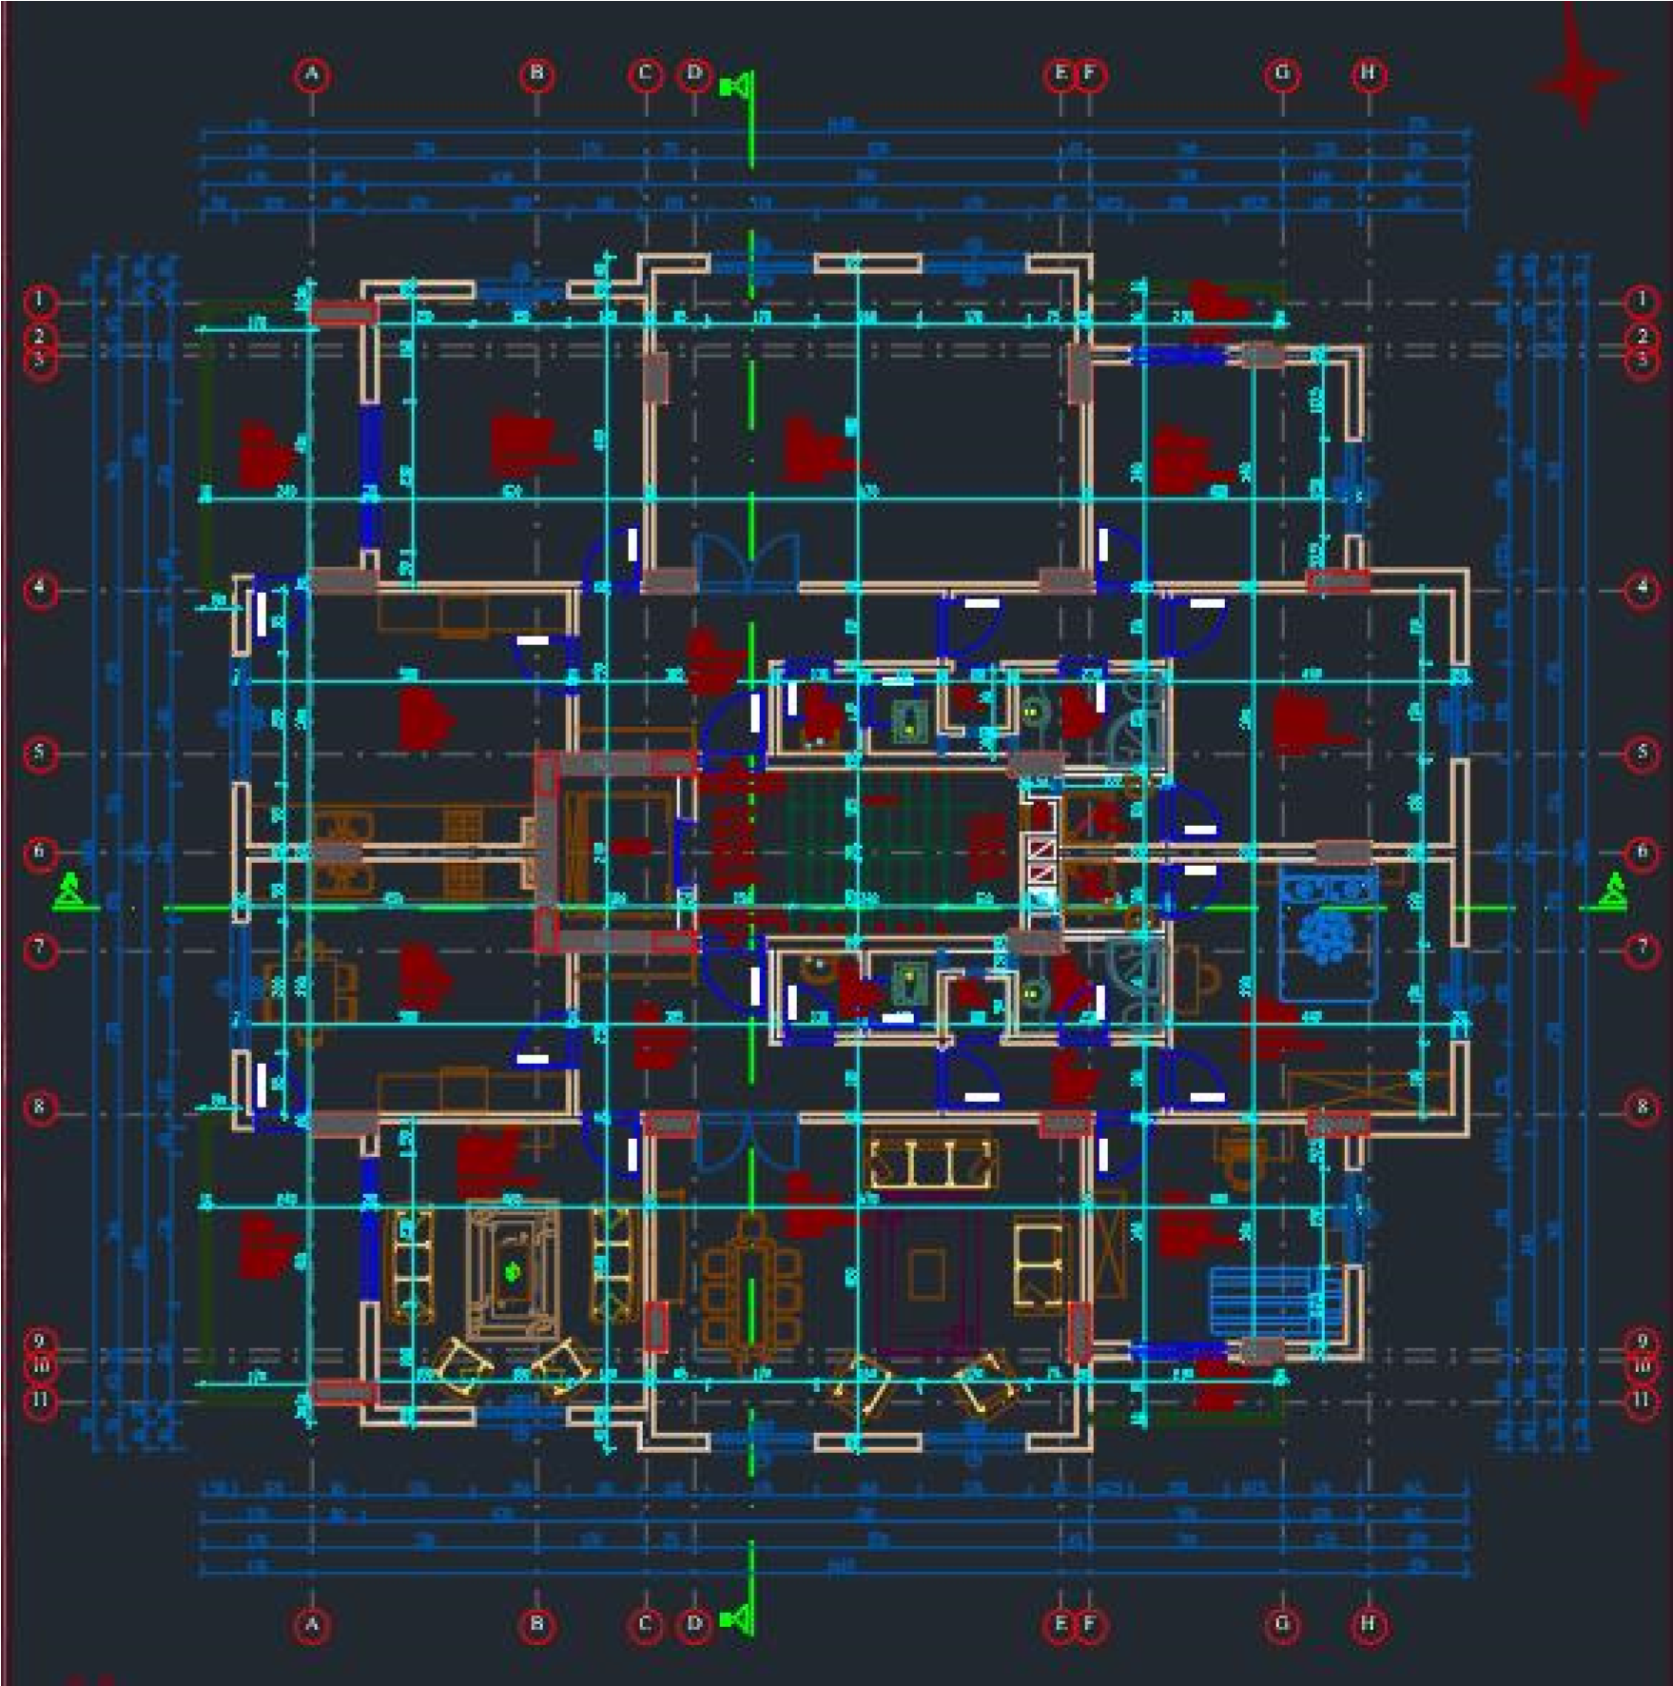

Slide 9
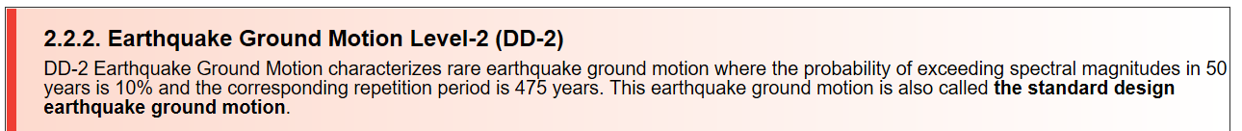
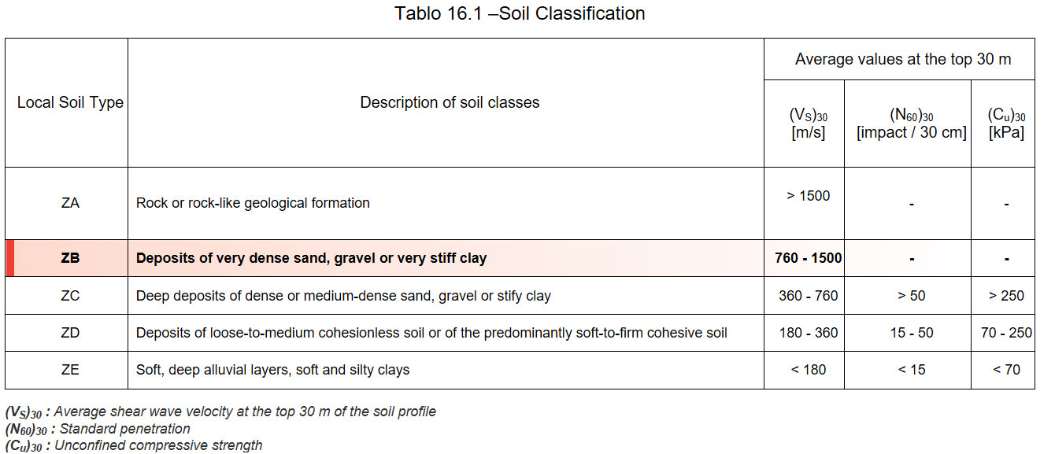
4. BUILDING PARAMETERS
RELATED WITH TBDY 2018

Slide 10
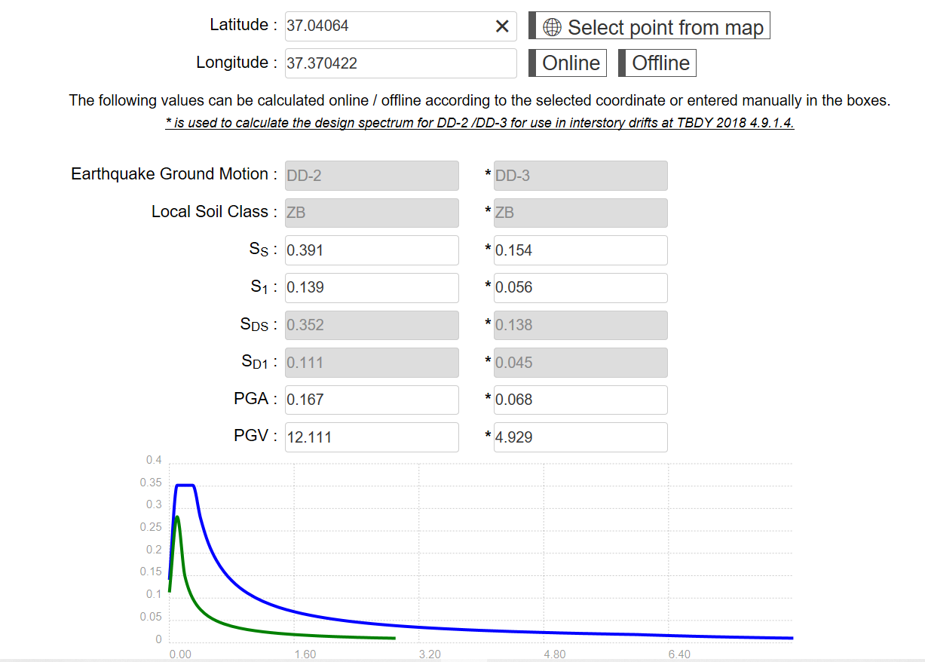

Slide 11
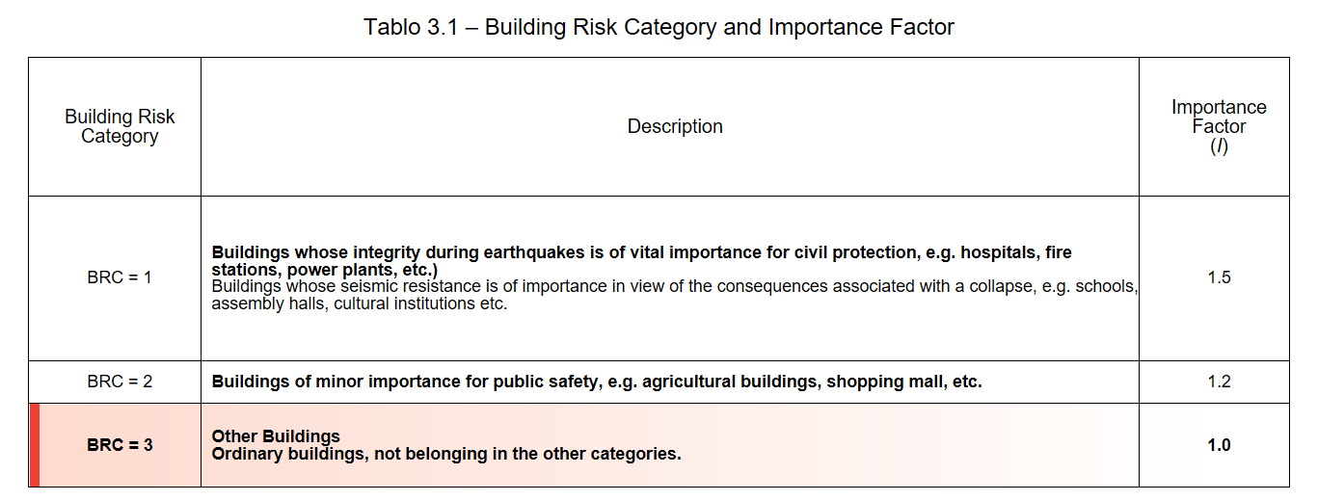
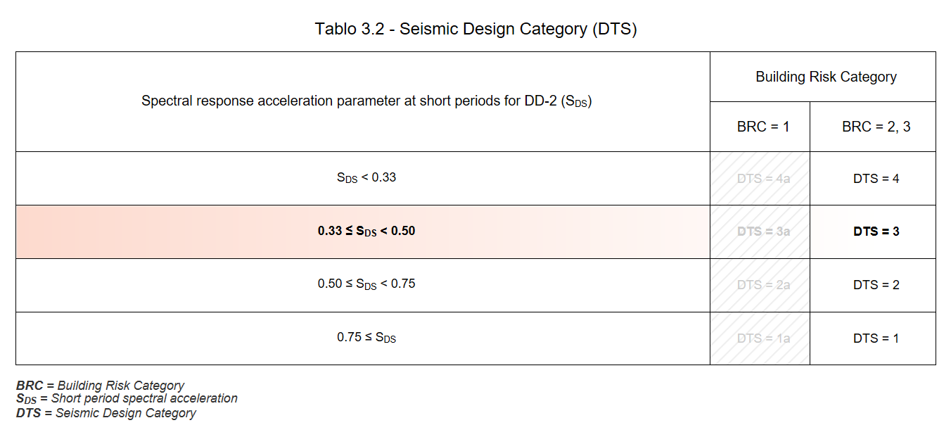

Slide 12
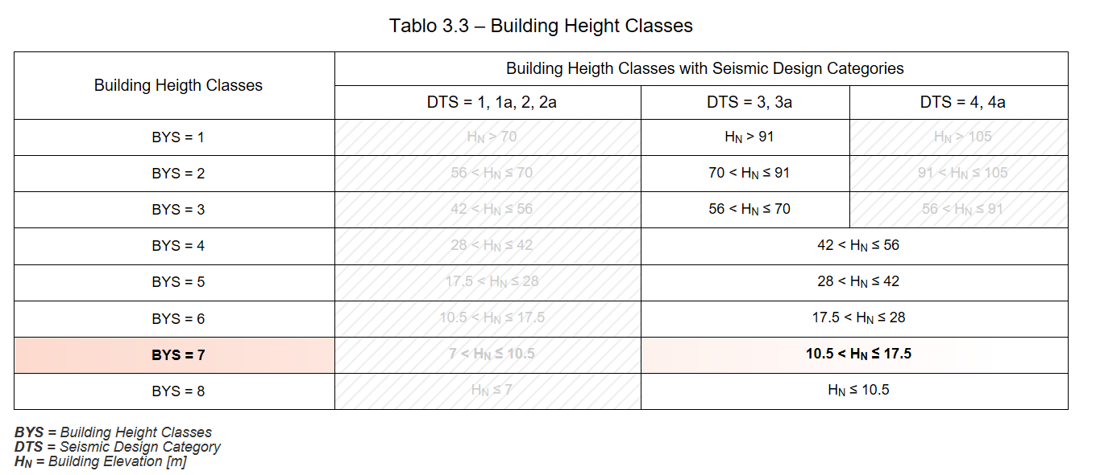
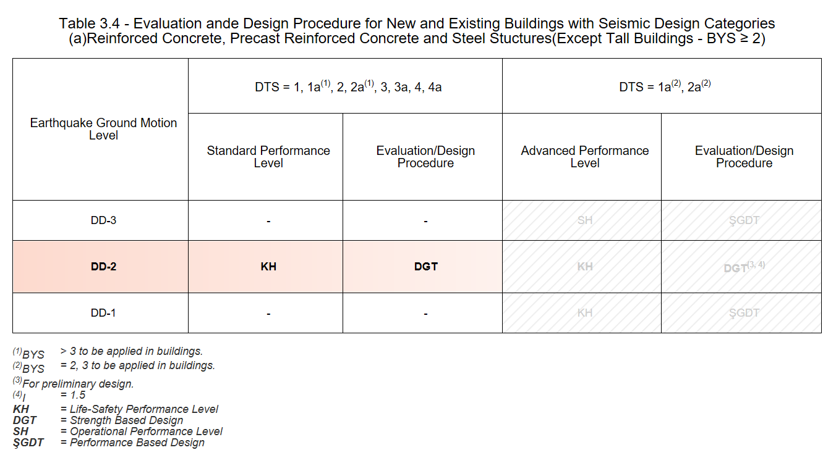

Slide 13
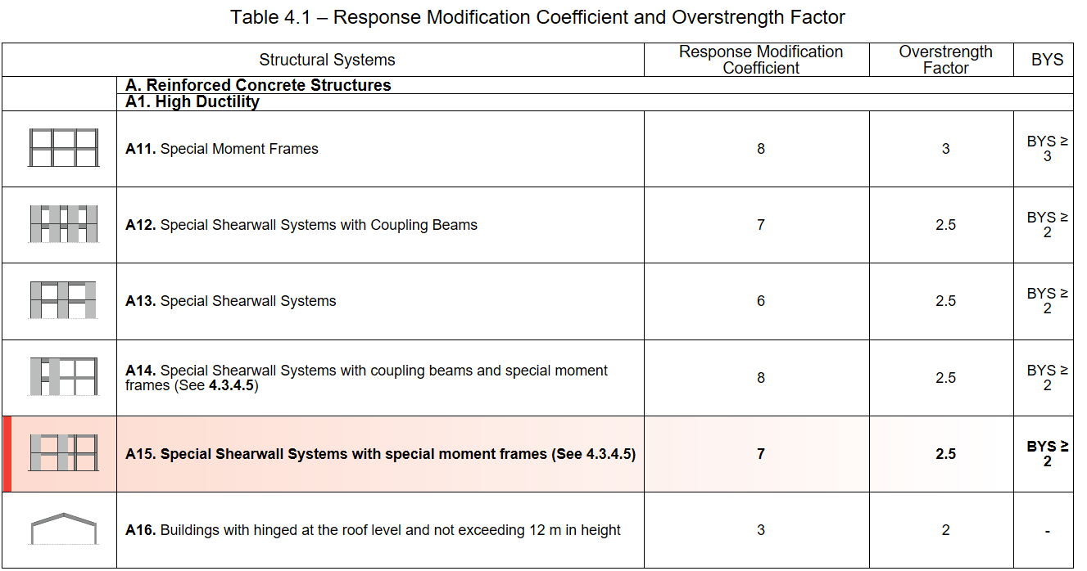
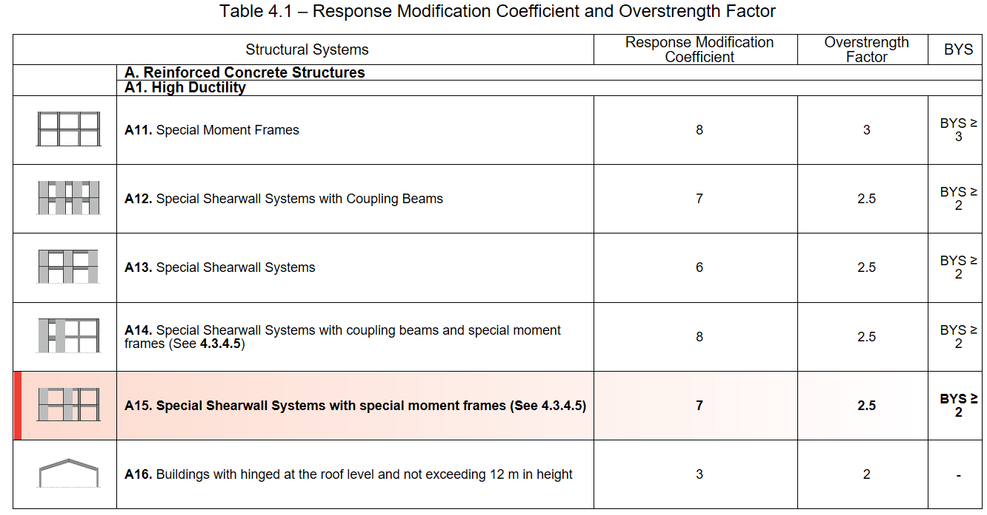

Slide 14
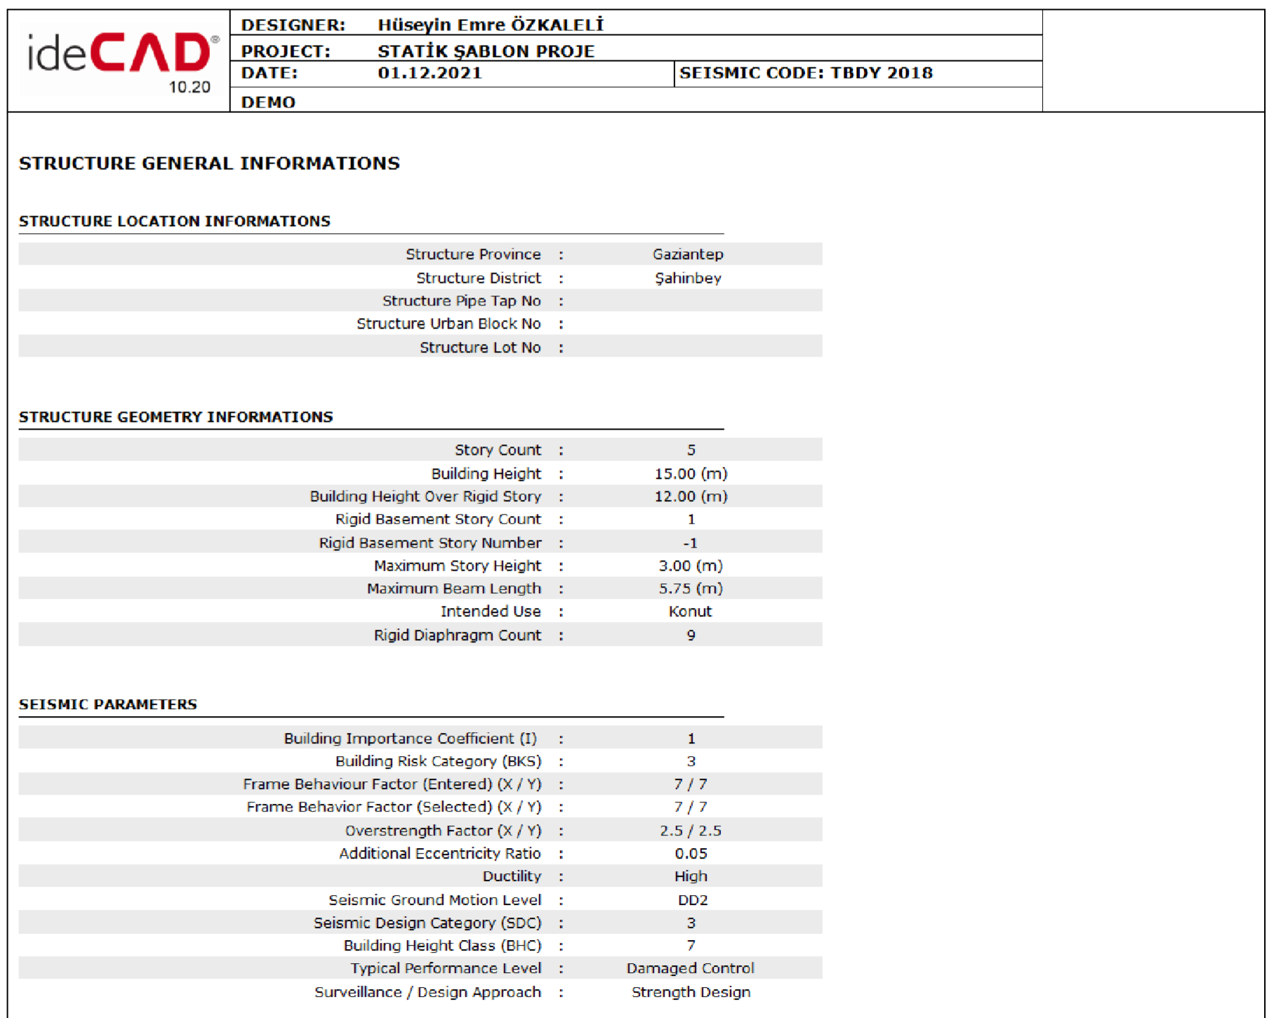
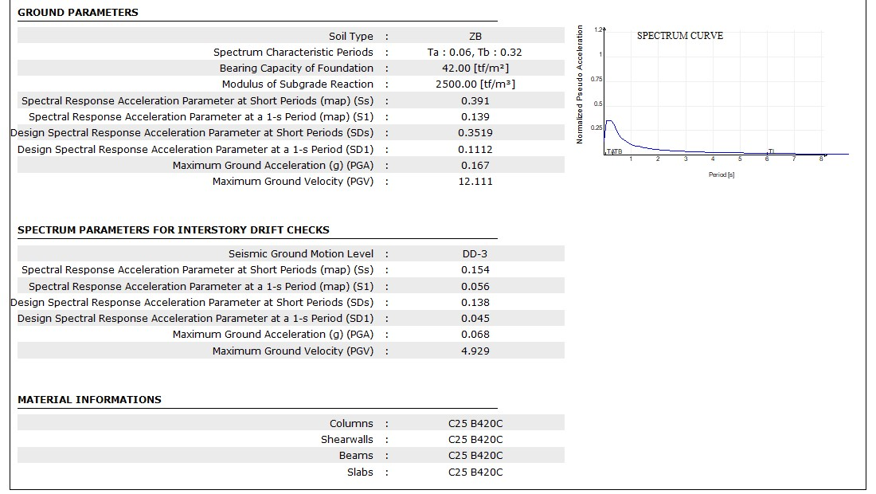
5. STRUCTURE GENERAL INFORMATIONS

Slide 15
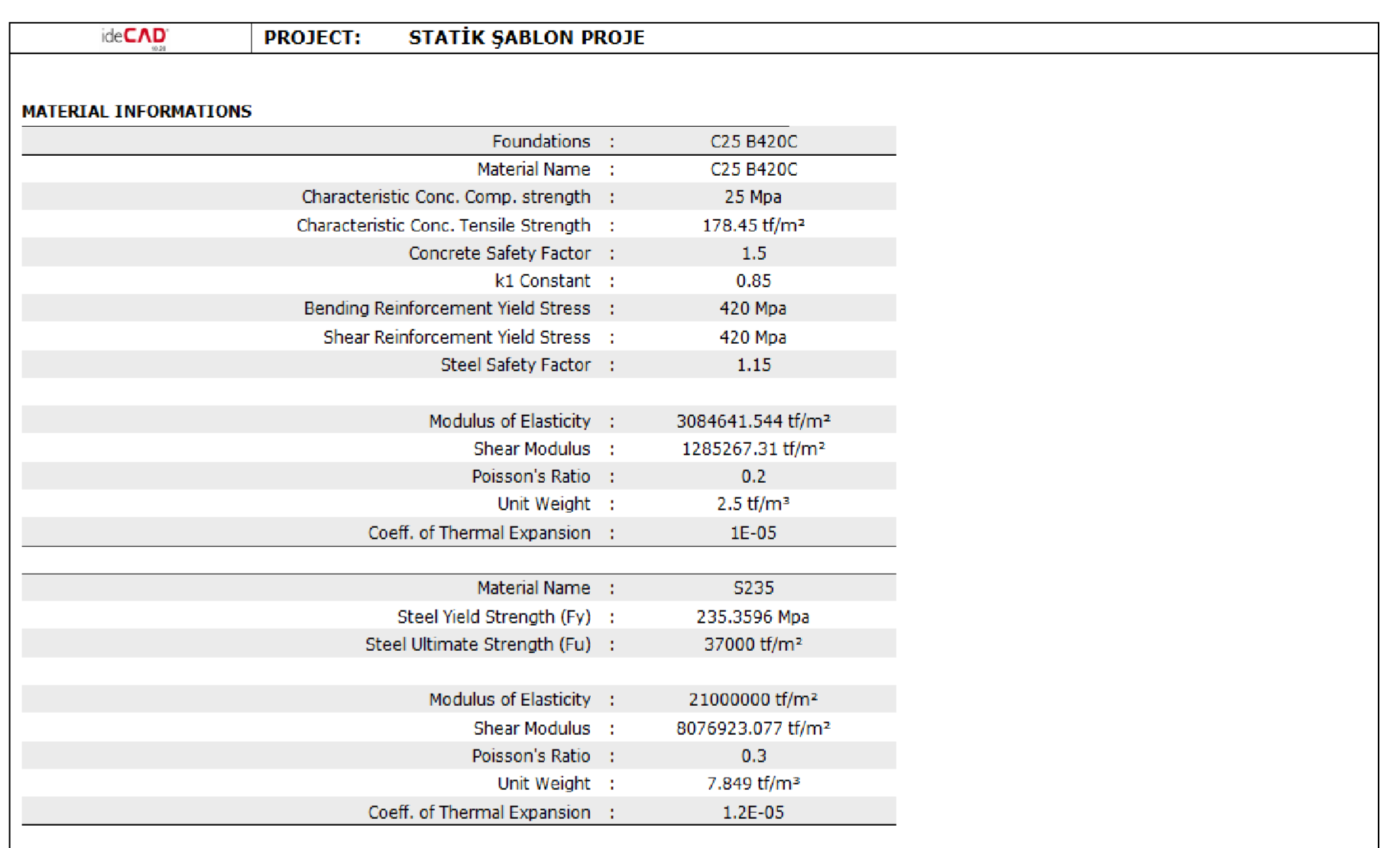
6. MATERIAL INFORMATIONS

Slide 16
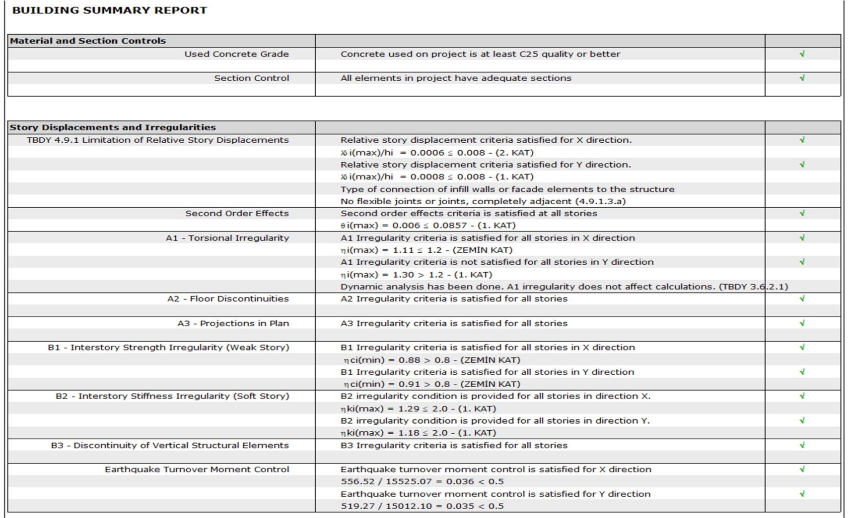
7. BUILDING SUMMARY REPORT

Slide 17
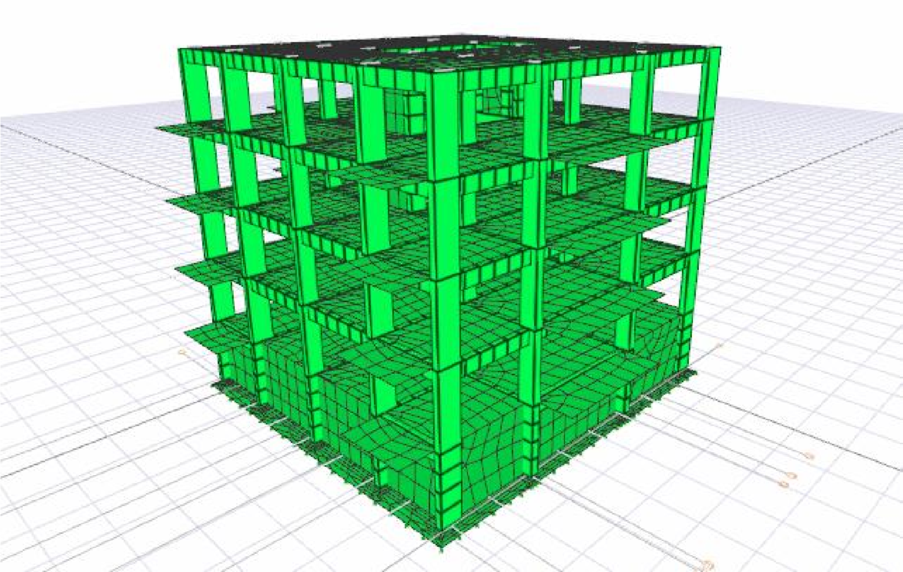
8. FIGURES AFTER ANALYSIS

Slide 18
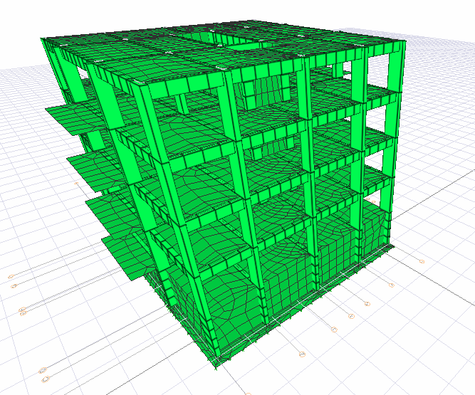

Slide 19
9. CONCLUSION
Within the scope of this project, I gained practical experience by reading the project in a common static analysis program of the basic lessons I took theoretically and then modeling it by experiencing what to do before starting a project. In addition, I tried to correct my deficiencies and mistakes by making the necessary efforts for the correction of many technical and systemic errors that I encountered during my project work.
Within the scope of this project, I saw how a project can be modeled and analyzed by using the Turkey Building Earthquake regulation on modeling and analysis of the parameters required for a reinforced concrete structure. In addition, I had chance to do a lot of research on the internet and correct my deficiencies in issues which I didn’t know before.

Slide 20
10. REFERENCES
Turkish Building Earthquake Code 2018
Turkish Building Standards (TS 500)
Idecad Static Analysis Program

