Slide 1


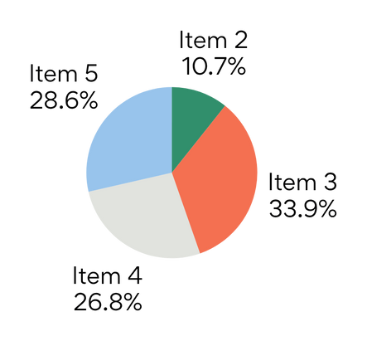
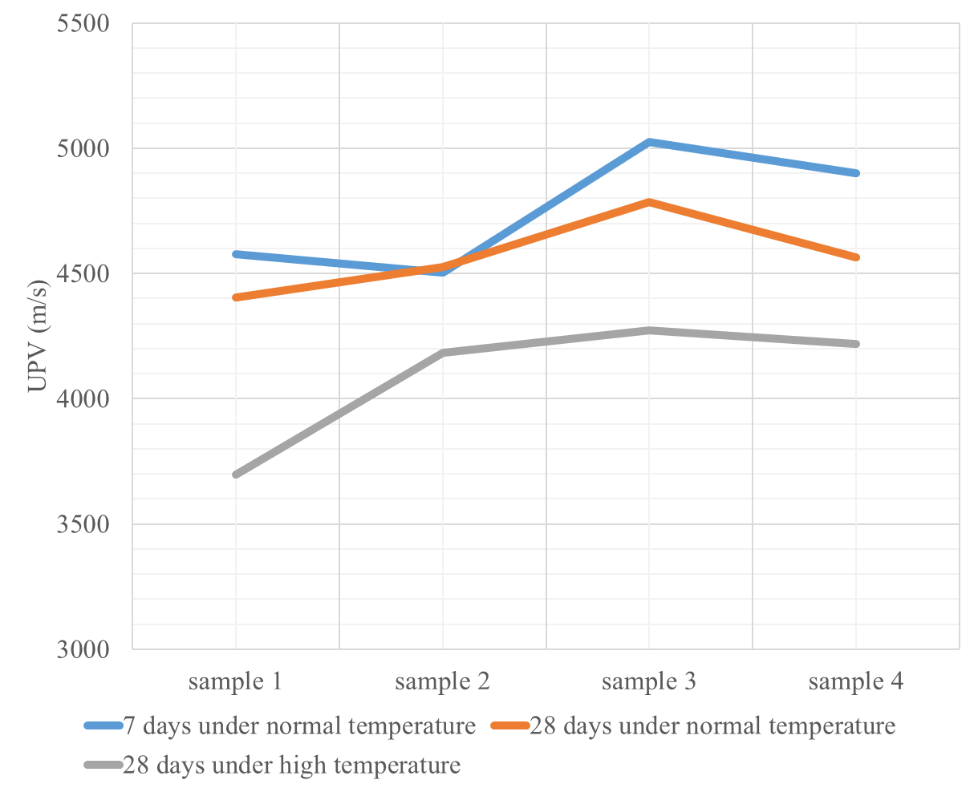
Engineering Faculty Proje Arastası 2025-2026 Spring
PROJECT TITLE
To be written in 32-point Gordita font, in bold, and in all capital letters.
AUTHORS: The author's name(s) should be written in 24-point Gordita font and in bold.
SUPERVISOR:The title and supervisor name should be written in 24-point Gordita font and in bold.
DEPARTMENT NAME (S)
SUMMARY
OBJECTIVE
Add a summary text of your project idea.
Explain what you want to achieve with your research.
INTRODUCTION
Introduce the subject of your research.
What are the questions about this topic you aim to answer?
Figure 1. Test Results
METHODOLOGY
RESULTS/FINDINGS
Let people know how you did your study. Methods can vary depending on the subject or results you want to see.
  State what you've found from your study.
  You can also list your findings in bullets.
Avoid too much technical detail or excessive jargon when presenting them.
Table 1. Raw Materials
Material | ρ (kg/dm³) | Water Absorption (%) | Humidity (%)
Natural Sand | 2.62 | 1.8 | 1.8
Naturally shaped coarse aggregate | 2.73 | 0.8 | 0
Crushed stone | 2.80 | 0.5 | 0
CEM I 42.5 N | 3.15
Glenium C303 Superplasticizer | 1.05
Figure 2. Comparison of average compressive strength of cylinder specimens.
CONCLUSION
REFERENCES
Summarize the key findings of your study. Address any limitations encountered during your research. End with a powerful closing statement that emphasizes the broader impact of your research.
RECOMMENDATIONS
Make suggestions for future research and practical applications based on the findings.
ACKNOWLEDGEMENT:

